Slide 1


AUTOMATIC POSTAGE PAYMENT (APP)
Presented By:
Divyanshu Kumar
BTECH/10159/21
(Software Developer Intern, Broadridge Bengaluru)
Name of the Industry Mentor : Mohit Rastogi
Name of the Institute Mentor : Dr. Aminul Islam
Department of ECE, BIT, Mesra, Ranchi-835215

Slide 2


ABOUT THE COMPANY
Broadridge
Securities Processing
Data and Analytics
Broadridge is a global fintech leader that provides investor communications and technology-driven solutions for wealth management, asset management and capital markets firms.
Investor Communication Solutions
Customer Communication
Digital Solutions

Slide 3
OUTLINE
Introduction
Motivation
Tech Stacks
Methodology
Future Work
Conclusion

Slide 4
INTRODUCTION
There are various business units in Broadridge. I am in BRCC(Broadridge Customer Communications) business unit.
BRCC is part of ICS – Broadridge Investor Communications Solutions. Broadridge Investor Communication Solutions, Inc. provides investor communication services.
The Company offers proxy mailing, vote processing, shareowner communication, meeting, disclosure, prospectus, analytics, and financial communication solutions.
APP which stands for Automatic Payment Postage, is a web application automates the payment process for postage, which means that every time we send a mail piece or package, the cost of postage is automatically deducted from a pre-funded account or charged to a selected payment method. This eliminates the need for manual transaction processing each time.

Slide 5
MOTIVATION
APP is a web application which is built on Ecomcore , which is custom framework(internal to broadridge)
Ecomcore framework is built on JAVA.
So in this project out team need to build the whole web application over Angular and Spring Boot framework keeping the DB connections same.
Here Angular for building frontend and Spring Boot for building Backend will be used.

Slide 6

TECH STACKS
Spring Boot:
Spring Boot is an open-source Java framework designed to simplify
the creation and deployment of Java applications.
It helps in Rapid Application Development.
Model-View-Controller (MVC) Architecture: Spring Boot follows the widely used MVC architecture pattern, where the application is divided into three main components: Model, View, and Controller. This helps to separate the concerns of the application and promotes the modularity and reusability of the code.
Dependency Injection: Spring Boot uses dependency injection to manage the dependencies between different components of the application. This allows for loose coupling between components and makes the code more maintainable and testable.

Slide 7
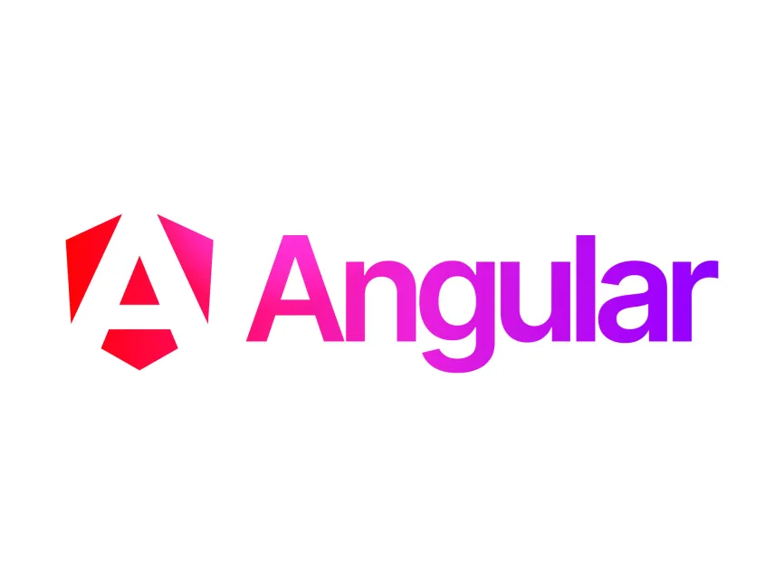
TECH STACKS
Angular:
Angular is a platform and framework for building single-page client
applications using HTML and TypeScript. Developed and maintained
by Google, it is a comprehensive framework for building modern web
applications.
Angular’s component-based structure allows for modular development. This means that each component encapsulates its own functionality and can be reused across different parts of an application, promoting better code organization and easier maintenance.
Angular’s two-way data binding automatically synchronizes data between the model and the view. This reduces boilerplate code and allows for more efficient and responsive user interfaces, as changes in the application state are automatically reflected in the UI.

Slide 8
METHODOLOGY
Progress Till Now:
I began by gaining a solid understanding of the Software Development Life Cycle. This foundational knowledge helped me appreciate the structured processes involved in software development.
Following this, I delved into various development methodologies, specifically Agile and Waterfall. I learned how Agile emphasizes iterative development and flexibility, fostering collaboration and adaptability in project management. In contrast, the Waterfall method presents a more linear and sequential approach, emphasizing thorough planning and documentation.
My training continued with a focus on Java, where I acquired a deep understanding of core Java concepts. This was crucial as it will lay the groundwork for my subsequent training in Spring Boot, a framework that facilitates the development of robust and scalable Java applications.

Slide 9
METHODOLOGY
Additionally, I also went through MS SQL training to become acquainted with database management. This involved learning how to effectively design, query, and manipulate databases.
To broaden my skill set, I also received training in JavaScript and TypeScript. These languages are pivotal for front-end development and are essential prerequisites for mastering the Angular framework. This training enabled me to understand and implement dynamic and interactive web applications.
Right now I am learning Angular which is front-end framework.

Slide 10
FUTURE WORK
After learning angular, spring boot training will start and also along with that I would be working on the front-end part of the project.
After spring boot training I would be working on backend part as well and apply the theoretical knowledge gained during training to real-world scenarios within the project.

Slide 11
CONCLUSION
The transformation of the APP web application from the Ecomcore framework to a modern architecture using Spring Boot and Angular not only updates the technological foundation of the application but also enhances its scalability, maintainability, and user experience.
Throughout the process, leveraging Angular for the front-end will allow us to create a responsive and dynamic user interface, while Spring Boot on the back-end will provide a robust environment for developing scalable and efficient application logic.

Slide 12
THANK YOU

